Slide 1
Title

Slide 2





Newly launched e commerce company is planning to secure next round of funding
Dashboards for different stakeholders which helps in tracking business metrics and KPIs
Detailed analysis of performance of business, sales and performance of new product
BUSINESS CONTEXT
Insights and Reports to tell a compelling story to investors

Slide 3
DATA AVAILABILITY
The database contains six related tables with e commerce data about website activity, products and orders.
The six tables are
Orders Table
Order Item Table
Order Item Refund Table
Products Table
Website Sessions
Website Pageviews
E COMMERCE DATA
Orders
Order items
Order item refunds
Products
Website sessions
Website Pageviews

Slide 4
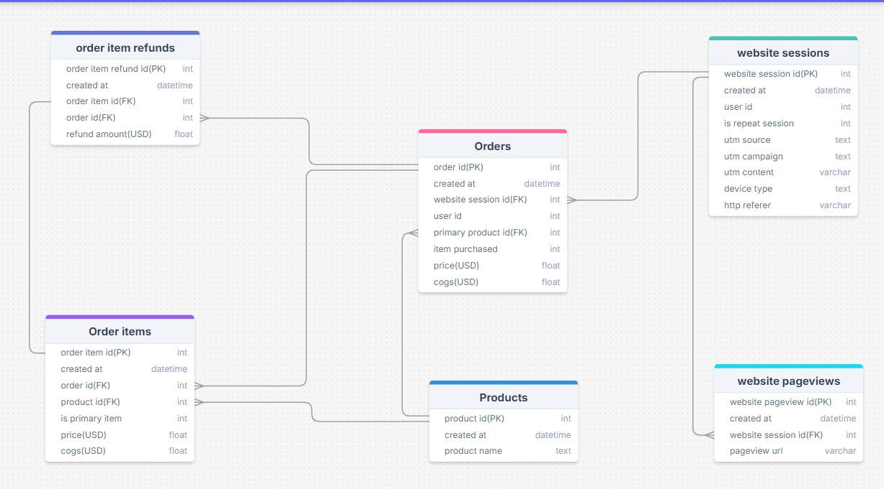
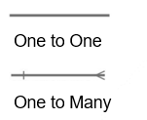
ER DIAGRAM

Slide 5
TABLE LEVEL AUDIT
Table Name | Rows | Columns | Duplicate values | Null values | Encoding | Primary key | Foreign key
Orders | 32313 | 8 | No | No | No | Order id | Website session id, primary product id
Order items | 40025 | 7 | No | No | Yes | Order item id | Order id, product id
Order item refunds | 1731 | 5 | No | No | No | Order item refund id | Order item id, Order id
Products | 4 | 3 | No | No | No | Product id | NA
Website sessions | 472871 | 9 | No | Yes | Yes | Website session id | NA
Website pageviews | 1188124 | 4 | No | No | No | Website pageview id | Website session id

Slide 6
COLUMN LEVEL AUDIT-1
Orders
 | Order id | Created at | Website session id | User id | Primary product id | Items purchased | price | cogs
Unique records | 32313 | 32299 | 32313 | 31696 | 4 | 2 | 10 | 10
Type of data | categorical | Date time | categorical | categorical | categorical | numerical | numerical | numerical
Missing values | No | No | No | No | No | No | No | No
Encoding | No | No | No | No | No | No | No | No
Products
 | Product id | Created at | Product name
Unique record | 4 | 4 | 4
Type of data | categorical | Date time | categorical
Missing values | No | No | No
Encoding | No | No | No

Slide 7
COLUMN LEVEL AUDIT-2
Order items
 | Order item id | Created at | Order id | Product id | Primary item | price | cogs
Unique records | 40025 | 32299 | 32313 | 4 | 2 | 4 | 4
Type of data | categorical | Date time | categorical | categorical | categorical | numerical | numerical
Missing values | No | No | No | No | No | No | No
Encoding | No | No | No | No | Yes | No | No
Order item refunds
 | Order item refund id | Created at | Order item id | Order id | Refund amount
Unique records | 1731 | 1731 | 1731 | 1723 | 4
Type of data | categorical | Date time | categorical | categorical | numerical
Missing values | No | No | No | No | No
Encoding | No | No | No | No | No

Slide 8
COLUMN LEVEL AUDIT-3
Website sessions
 | Unique record | Type of data | Missing values | Encoding
Website session id | 472871 | Categorical | No | No
Created at | 470444 | Date time | No | No
User id | 394318 | categorical | No | No
Repeat session | 2 | categorical | No | Yes
Utm source | 3 | categorical | Yes | No
Utm campaign | 4 | categorical | Yes | No
Utm content | 6 | categorical | Yes | No
Device type | 2 | categorical | No | No
http referer | 3 | categorical | Yes | No
Website pageviews
 | Unique record | Type of data | Missing values | Encoding
Website pageview id | 1188124 | categorical | No | No
Created at | 1171962 | Date time | No | No
Website session id | 472871 | categorical | No | No
Pageview url | 16 | categorical | No | No

Slide 9
COLUMN DESCRIPTION-1
Orders
Column | Description
Order id | Unique identifier for each order
Created at | Timestamp of when the order was placed
Website session id | Session identifier on the website
User id | ID of the user who placed the order
Primary product id | product ID in the order
Items purchased | Number of items purchased in this order
Price usd | Total price paid (in USD)
Cogs usd | Cost of Goods Sold (COGS) for the order (USD)
Products
Column | Description
Product id | Unique identifier for each product
Created at | Timestamp indicating when the product was added to the website
Product name | Name of the product

Slide 10
COLUMN DESCRIPTION-2
Order items
Column | Description
Order item id | Unique identifier for the order item
Created at | Timestamp of the order
Order id | ID linking this item to a specific order
Product id | Product identifier for the item
Is primary item | Indicates if this is the primary product( 1 for primary item and 0 for non primary item)
Price usd | Price of the item in USD
Cogs usd | Cost of goods sold (COGS) for the item

Slide 11
COLUMN DESCRIPTION-3
Order item refunds
Column | Description
Order item refund id | Unique identifier for the refund transaction
Created at | Timestamp indicating when the refund was processed
Order item id | Reference to the item that was refunded
Order id | Reference to the associated order for the refunded item
Refund amount usd | Amount of the refund in USD
Website pageviews
Column | Description
Website pageview id | Unique identifier for each pageview
Created at | Timestamp of when the pageview occurred
Website session id | Identifier linking the pageview to a specific website session
Pageview url | URL of the page that was visited

Slide 12
COLUMN DESCRIPTION-4
Website sessions
Column | Description
Website session id | Unique identifier for each website session
Created at | Timestamp indicating when the session started
User id | Unique identifier of the user associated with the session
Is repeat session | Indicates if this session is a repeat session for the user (0 = No, 1 = Yes)
Utm source | The source of the session’s traffic (e.g., gsearch for Google Search)
Utm campaign | Campaign identifier for tracking the session’s source (e.g., nonbrand)
Utm content | The content variation of the ad (e.g., g_ad_1)
Device type | The device type used for the session (e.g., desktop or mobile)
http referer | URL that referred the user to the website

Slide 13
Utm_content
WEBSITE SESSIONS AUDIT-1
1. Social_ad_1 and social_ad_2
Social_ad_1 and social_ad_2 doesn’t direct users to /home page.
Social_ad_1 is for pilot campaign and for both desktop and mobile users.
Social_ad_2 is for desktop targeted campaign and desktop users only.
Utm source is socialbook only.
2. G_ad_1 and g_ad_2
G_ad_1 is for nonbrand campaign and for both mobile and desktop users.
G_ad_2 is for brand campaign and for both mobile and desktop users.
3. B_ad_1 and b_ad_2
B_ad_1 is for nonbrand campaign, doesn’t direct users to /home page and for both mobile and desktop users.
B_ad_2 is for brand campaign and for both mobile and desktop users.

Slide 14
Utm_campaign
WEBSITE SESSIONS AUDIT-2
Utm_source
1.Brand
Utm_source is gsearch and bsearch.
Utm_content is only g_ad_2 and b_ad_2.
1.Gsearch
Utm_campaign is brand and nonbrand.
Utm_content is only g_ad_1 and g_ad_2.
For both mobile and desktop users.
2.Nonbrand
Utm_source is gsearch and bsearch.
Utm_content is only g_ad_1 and b_ad_1.
2.Bsearch
3.Desktop targeted
Utm_campaign is brand and nonbrand.
Utm_content is only b_ad_1 and b_ad_2.
For both mobile and desktop users.
Utm_source is socialbook.
Utm_content is only social_ad_2.
For desktop users only.
3.Socialbook
4.Pilot
Utm_campaign is desktop_targeted and pilot.
Utm_content is only social_ad_1 and social_ad_2.
For both mobile and desktop users.
Utm_source is socialbook.
Utm_content is only social_ad_1.
For both mobile and desktop users.

Slide 15
WEBSITE SESSIONS AUDIT-3
Page | Direct | Don’t Direct | Campaign Used
/home | g_ad_1, g_ad_2, b_ad_2 | Social_ad_1, social_ad_2, b_ad_1 | Brand, Nonbrand
/lander-1 | b_ad_1, g_ad_1 | g_ad_2, b_ad_2, social_ad_1, social_ad_2, source(socialbook) | Nonbrand
/lander-2 | b_ad_1, g_ad_1, social_ad_1, social_ad_2 | g_ad_2, b_ad_2 | Nonbrand, desktop targeted
/lander-3 | b_ad_1, g_ad_1, social_ad_1 | g_ad_2, b_ad_2, social_ad_2 | Nonbrand, pilot
/lander-4 | b_ad_1, g_ad_1 | g_ad_2, b_ad_2, social_ad_1, social_ad_2, source(socialbook) | Nonbrand
/lander-5 | b_ad_1, g_ad_1 | g_ad_2, b_ad_2, social_ad_1, social_ad_2, source(socialbook) | Nonbrand
/billing | g_ad_1, g_ad_2, b_ad_1, b_ad_2 | Social_ad_1, social_ad_2 | Brand, Nonbrand
/billing-2 | All | nil | all
/the-hudson-river-mini-bear | g_ad_1, g_ad_2, b_ad_1, b_ad_2, social_ad_2 | Social_ad_1 | Brand, Nonbrand, desktop targeted
/the-birthday-sugar-panda | all | nill | all
/the-original-mr-fuzzy | all | nill | all
/the-forever-love-bear | all | nill | all

Slide 16
WEBSITE SESSIONS AUDIT-4
SOME KEY OBSERVATIONS
/lander-3 is for mobile users only.
/lander-4 and /lander-5 are for desktop users only.
Only /home is a page where for some records utm_source, utm_campaign, utm_content and http_referrer is not available(NULL).
Users buying from socialbook are not directed to /billing page for the transactions.

Slide 17
WEBSITE PAGEVIEWS AUDIT
Direct type-in
Unpaid
Organic
If Utm_content is NULL
If Utm_content is NULL and http_referrer is also NULL
If utm_content is NULL and http_referrer is google.com
SOME KEY OBSERVATIONS
If utm_content is NULL it is “Unpaid” search
If utm_content is NULL and http_referrer is also NULL, then it is “Direct type in”
If utm_content is NULL and http_referrer is google.com, then it is “Organic search”
-------------------------------------------------------------------
NULL is “Unpaid” search and we have 2 categories in it. 1.Direct type-in and 2.Organic
Everything else is “Paid” search.

Slide 18
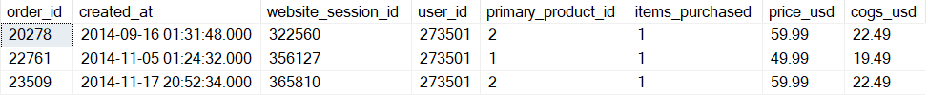
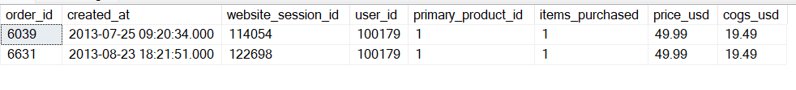
OBSERVATIONS-1
One user id has multiple website session id
No 2 users are assigned with same session ids.
One user id has multiple order id

Slide 19
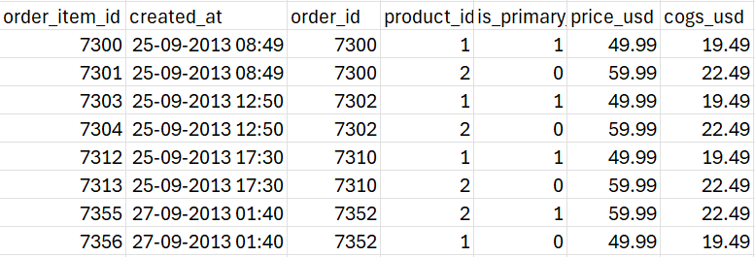
OBSERVATIONS-2
For all the 14 duplicate created at (timestamp), there are different order id , different session id, different user id. Each duplicate timestamp corresponds to different website session id and user id pairs, suggesting that these might be legitimate simultaneous orders from different users
One order id has multiple order item id

Slide 20
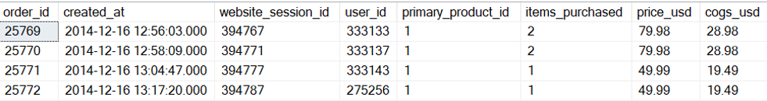
OBSERVATIONS-3
When primary product id is 1 and item purchased is 1 , then price is $ 49.99 and cost is $ 19.49(for most of the cases). When primary product is 1 and item purchased is 2, then price is $79.98 and cost is $28.98(for most of the cases)
But in some cases where primary product id is 1 and item purchased is 2 then their price is either $95.98 or $109.98

Slide 21
OBSERVATIONS-4
In orders table, No of items purchased is either 1 or 2 only.
Find price and cost of each product
Price of product is not given in products table. According to orders table the prices and cost of products are descripted below:
Product_id | Price_usd | Cogs_usd
1 | 49.99 | 19.49
2 | 59.99 | 22.49
3 | 45.99 | 14.49
4 | 29.99 | 9.49
21
Image source: icons8`

Slide 22
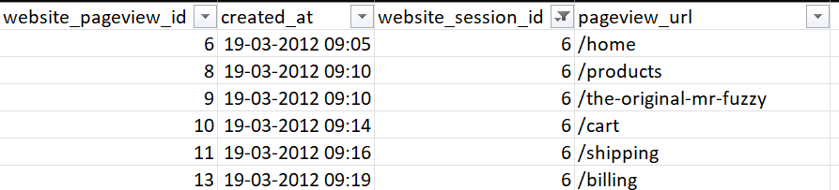
OBSERVATIONS-5
Only one item in orders can be primary item and it is encoded as 1 (Orders table )
Cogs are the cost to the company and then the company puts some profit margin and fix the price which is MRP of the product.
For user_id 489, is_repeat _session column has 2 values 0 and 1 in website_sessions table, his first visit is on 21-03-2012 indicating is_repeat_session is zero and when the user visits 2nd time on 25-03-2012 the is_repeat session is 1.
One website contains multiple pageviews and they are in sequential order (website_pageviews table).
22
Image source: icons8`

Slide 23
Data Integrity Checks
01
Check null value
04
Column datatype verification
02
Check key level duplicates
05
Calculated Min, Max , Average to detect any outliers
03
Data Encoding check

Slide 24


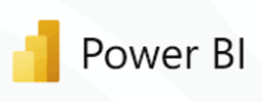
Technology stacks used
Preliminary Data Auditing
Chart Creation
Data extraction , Transformation and Analysis
Dashboard Preparation

Slide 25

EXPLORATORY
DATA ANALYSIS

Slide 26
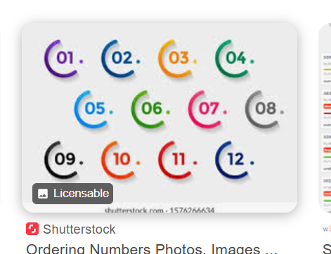
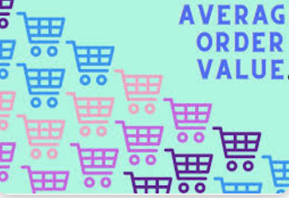




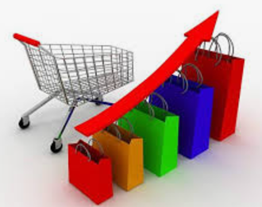



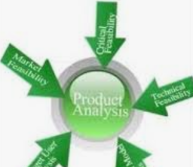




High Level Metrics
32,313
Number of orders
1.23
Avg no of items per order
1.16M
Net profit
1.85M
Net revenue
40,025
Total quantity
168.35%
Profit percentage
59.99
Avg. order value
29.49
Avg. number of daily transaction
38.36
Avg. Profit per customer
61.15
Avg sales per customer
4
Total products
1.18M
Total no of pageviews
6.9L
Net Cogs
46.4
Avg. product price
16
Types of Pages

Slide 27

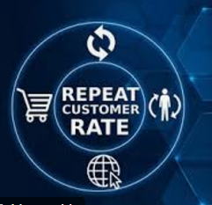
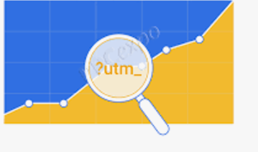







High Level Metrics
85.33K Total refund
591
Repeat customers
4 (including null)
Types of utm_sources
4.40%
Refund amount
percentage
35
Avg. no of days b/w 2 txn. for repeat customers
7( including null)
Types of utm_content
4.32%
Refund item percentage
4.72L
No. of sessions
5 (including null)
Types of utm campaign
3.94L
Numbers of users
1.19
Avg. no. of sessions per user
4 (including null)
Type of http referrer
2
Types of devices used
46.4
Avg. product price
31,696
Number of customers
46.4
Avg. product price

Slide 28

BUSINESS PATTERNS & SEASONALITY

Slide 29
BUSINESS PATTERNS & SEASONALITY - 1
Sessions and orders by monthly for 2012
Image source: icons8`

Slide 30
BUSINESS PATTERNS & SEASONALITY - 2
Sessions and orders by weekdays for 2012

Slide 31
Observations
BUSINESS PATTERNS & SEASONALITY - 3
Peak Orders Month: For year 2012, Both sessions and orders hit highest in November month hitting about 14K sessions and 618 orders .
Trend: In 2012, Both sessions and orders are gradually increased from January to November and decreased suddenly in December month.
Correlation: The “Orders” line seems to follow the same seasonal pattern as the “Sessions” , indicating that the number of orders are in positive correlation with the overall sessions volume by each month.
Peak Orders Day: For year 2012, Both sessions and orders hit highest on Friday hitting about 11K sessions and 508 orders and almost similar to Monday.
Trend: In 2012, Both sessions and orders hit very high on Monday and little decreased on next days till Friday and peaked again on Friday and recorded very less on weekends(Saturday & Sunday).
Correlation: The “Orders” line seems to follow the same seasonal pattern as the “Sessions” , indicating that the number of orders are in positive correlation with the overall sessions volume by each day.

Slide 32
BUSINESS PATTERNS & SEASONALITY - 4
Average website session volume, categorized by hour of the day and weekday between September 15th and November 15th, 2013 excluding holidays(Sundays)
Average_Sessions = Total sessions count / Number of unique days (excluding Sundays) in the specified date range(between September 15th and November 15th, 2013).

Slide 33
Observations
BUSINESS PATTERNS & SEASONALITY - 5
Peak Session Volume Days: Average session volume peaked in Wednesday’s hitting 64 sessions per day.
Trend: The average session volume start increasing from Monday to Wednesday hitting highest and decreased gradually till Saturday which is hitting the lowest 16 sessions per day.
Reason: This could be most of the customers are preferring shopping outside with their families at weekends.
Peak Session Volume Hours: Average session volume peaked in afternoon hours[11 AM – 3 PM] hitting 22 sessions per hour on an average.
Trend: The average session volume is very low from 12 AM to 7 AM and increased gradually till 3 PM hitting highest and again gradually decreased till 11 PM.
Reason: This could be most of the customers are very less active at mid nights till morning and very active in daytimes and keeps on decreasing towards night time.

Slide 34
BUSINESS PATTERNS & SEASONALITY - 6
Monthly trends to date for number of sales, total revenue and total margin generated for business
Image source: icons8`

Slide 35
Observations
BUSINESS PATTERNS & SEASONALITY - 7
Trend: The upward trend suggests that the business is growing through the time period.
Seasonality: The recurring peaks and troughs suggest that there are factors influencing sales that are cyclical or seasonal. These could be related to factors like holidays, weather, or economic conditions.
Peak Sales: The peak sales are noticed in December, 2014 and decreased after till the last and also the revenue and margin.
Correlation: The “Revenue” and “Margin” seems to follow the same seasonal pattern as the “Total Sales” line, indicating that they are influenced by the overall sales volume.

Slide 36
BUSINESS PATTERNS & SEASONALITY - 8
Orders by each month
The first quarter (January-March) has higher order volumes, peaking in February.
Order counts remain relatively low from April through August, might suggest that demand for the product is weaker during spring and early summer months.
November and December see significant growth, with December reaching the peak for the year. This could be due to holiday shopping or year-end promotions.

Slide 37
BUSINESS PATTERNS & SEASONALITY - 9
Recommendations
1.Optimize Traffic During Peak Periods:
November shows the highest session and order volumes in 2012. This indicates a peak period for customer activity, likely driven by seasonal demand (e.g., holiday shopping).
Action: Invest in paid search ads and promotional efforts leading up to November, especially focusing on driving more traffic and converting that traffic into orders.
2.Focus on Weekday Sales:
Sessions and orders peak on Fridays, with Monday also showing high engagement. This suggests that customers are more active early in the week and are more likely to place orders during the weekdays.
Action: Increase targeted marketing and promotional efforts on Mondays and Fridays, while optimizing the website for mobile use and ease of navigation during these high-traffic days.

Slide 38
BUSINESS PATTERNS & SEASONALITY - 10
Recommendations
3.Improve Customer Engagement in the Weekends:
Weekends have significantly lower session and order volume, indicating potential untapped opportunities for growth.
Action: Develop weekend-specific campaigns or offers to boost engagement, such as flash sales or weekend-only discounts. Additionally, consider pushing for engagement through social media channels during weekends to attract more customers.
4.Target Peak Session Hours (Afternoon):
The highest session volumes occur between 11 AM - 3 PM, suggesting that this is when customers are most active.
Action: Schedule targeted ad campaigns, promotions, and content releases during these peak hours to align with customer activity. Optimize customer service responses during these hours to ensure swift support.

Slide 39
BUSINESS PATTERNS & SEASONALITY - 11
Recommendations
5.Leverage Top Performing Traffic Sources for Retargeting:
GSEARCH accounts for a significant portion of new and repeat customers. This demonstrates the effectiveness of paid search traffic in driving both acquisition and retention.
Action: Continue investing in paid search ads, especially Google Ads. Consider allocating more budget toward GSEARCH and experiment with retargeting ads to boost repeat customer conversion.
6.Reduce Dependence on Low-Performing Channels:
Channels like SOCIALBOOK and BSEARCH are underperforming with low repeat and new customer contributions.
Action: Reassess the strategies for these channels. If they are not yielding results, either reduce spending or test new types of campaigns to improve engagement. Alternatively, consider shifting the budget toward higher-performing channels like GSEARCH.

Slide 40


Slide 41
USER ANALYSIS - 1
Channels through which repeat customers return to our website, comparing them to new sessions

Slide 42
Observations
USER ANALYSIS - 2
Top Channels: Highest no of repeat customers are coming from “NULL” channel with count 426 which is contributing 46% to the total followed by “GSEARCH” with count 396 contributing 43% to the total.
Worst Channels: Very less repeat customers are from “SOCIALBOOK” which is just 0.44% to the total followed by “BSEARCH” contributing 9.6% .
Result: Repeat customers predominantly come through direct type-in and there’s a significant portion that originates from paid search ads.
Top Channels: Very huge no of new customers are coming from “GSEARCH” channel with count around 14K and contributing 65% to the total.
Worst Channels: Very less new customers are coming from “SOCIALBOOK” which is just 1.59% to the total followed by “BSEARCH” contributing 13.6% and “NULL” contributing 19.6%.
Result: New customers mostly come through direct type-in and there’s a significant portion that originates from paid search ads.

Slide 43
USER ANALYSIS - 3
Analyzing Repeat Behaviour
1.Website visitors who come back for another session from 2014 to date
No of Repeat Visitors after 2014
35,005
2.Minimum , maximum and average days between the first and second session for customers who do come back after 2014
Min days b/w two sessions | Max days b/w two sessions | Avg days b/w two sessions
1 | 105 | 34

Slide 44
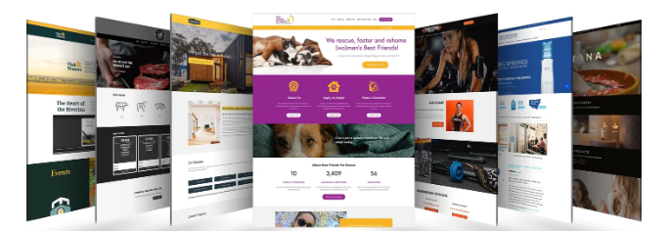
WEBSITE PERFORMANCE ANALYSIS

Slide 45
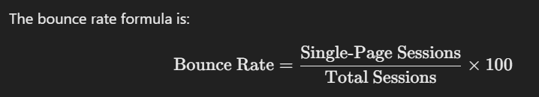
WEBSITE PERFORMANCE ANALYSIS-1
Bounce Rate
Among the landing pages, /lander-5 has the lowest bounce rate at 36%, which suggests it may have more effective content or layout for retaining visitors compared to others.
Data is suggesting that users are frequently leaving these pages like /lander-1 (53%) and /lander-4 (51%) without further interaction.
The /home page has a lower bounce rate of 41%, indicating it may engage visitors better or lead them to other parts of the site.

Slide 46
WEBSITE PERFORMANCE ANALYSIS-2
Top Landing Pages Views
The /home page has the highest page views followed closely by /lander-2 and are likely entry points or high-interest areas, potentially driving a significant portion of user engagement.
Pages /lander-3 and /lander-5 are moderately popular, indicating they are effective but could benefit from additional optimization to increase engagement.
Pages /lander-1 and especially /lander-4 have lower views, and may not be as effective in attracting or retaining user interest, suggesting a need for content or structural improvements.

Slide 47
WEBSITE PERFORMANCE ANALYSIS-3
Comparison between /lander-1 and /home page
Traffic in both pages by weekdays
For the gsearch nonbrand campaign before '2012-07-28'
pageview_url | Bounce_rate
/home | 60
/lander-1 | 53
The /lander-1 page consistently receives more traffic than the /home page, especially noticeable on Tuesday and Thursday, indicating it may be a preferred landing page.
Both pages experience the highest traffic on Wednesday and Thursday, which suggests that users are more active mid-week.
Both pages see a significant drop in traffic on Saturday and Sunday, which could indicate lower engagement over the weekend or different user behavior patterns.

Slide 48
WEBSITE PERFORMANCE ANALYSIS-4
Traffic conversion tests for /billing vs. new /billing-2 pages
pageview_url | Traffic(count of sessions) | Orders | Conversion Rate
/billing | 3617 | 1620 | 44.7
/billing-2 | 48441 | 30693 | 63.3
The /billing-2 page receives significantly more traffic compared to /billing, with a much higher conversion rate of compared to on /billing.
Both pages have high conversion rates, indicating they are effective in driving users to complete orders, with /billing-2 being especially successful.
The higher traffic and conversion rate suggest that users might prefer the /billing-2 page, possibly due to a better user experience or more streamlined process.
Business have to identify what drives higher conversions in /billing-2 and apply similar strategies to /billing page and do test enhancements on /billing to potentially improve its conversion rate and bring it closer to /billing-2 levels.

Slide 49
WEBSITE PERFORMANCE ANALYSIS-5
Page Views
The /products page has the highest views, indicating it’s a key landing or browsing page, with significantly more views than other pages.
Specific products like /the-original-mr-fuzzy also have high views, suggesting they are popular among users and could be used for cross-promotion.
Pages like /the-hudson-river-mini-bear and /billing have low views, suggesting less user interest or lower visibility, which may indicate areas for potential improvement or further analysis.

Slide 50
WEBSITE PERFORMANCE ANALYSIS-6
Recommendations
Boost Promotions in Peak Months: Increase marketing and promotions in high-demand months (January-March, November-December) to capitalize on natural sales spikes.
Target the Mid-Year Slump with Incentives (April-August)- To boost sales during slower months, consider running special mid-year promotions. This could include seasonal discounts, flash sales, or loyalty rewards to encourage purchases. Focus on building brand awareness through educational content, social media engagement, and product launches.
Build Engagement Programs- Consider loyalty programs or subscription-based models that encourage repeat purchases and send targeted emails or push notifications during the mid-year with personalized offers to keep customers engaged even during the off-peak season.
Optimize High-Traffic Pages: Ensure pages like /products and /the-original-mr-fuzzy are optimized for conversions, as they draw the most traffic.
Streamline Checkout Process: Evaluate and possibly simplify the checkout-related pages to reduce any friction points and improve the likelihood of conversions.
Enhance Visibility for Low-Traffic Pages: Consider promoting or optimizing underperforming pages to drive more engagement, or consolidate them if they don't add significant value.

Slide 51
WEBSITE PERFORMANCE ANALYSIS-7
Recommendations
Optimize High-Bounce Landers: Review content, layout, and calls-to-action on /lander-1 and /lander-4 to improve engagement and reduce bounce rates.
Leverage Success of /lander-5: Analyze the structure of /lander-5 to replicate successful elements on other pages.
Improve User Flow from /home: Since /home has a relatively low bounce rate, consider optimizing the navigation to direct users to key pages or high-value content.
Focus on Conversion Optimization- For /home and /lander-2 to maximize value from the high traffic on these pages.
Enhance Content- On /lander-3 and /lander-5 to potentially increase engagement further, as they are moderately popular.
Revamp- /lander-1 and /lander-4 to boost visibility and make them more appealing to visitors.
Target Promotional Efforts Mid-Week to capitalize on higher traffic days, especially on Wednesday and Thursday.
Consider Weekend Engagement Strategies such as tailored content or offers to drive more weekend visits.
Further Optimize /lander-1 since it attracts higher traffic than /home, potentially indicating its effectiveness as a landing page.

Slide 52

TRAFFIC SOURCE ANALYSIS

Slide 53
TRAFFIC SOURCE ANALYSIS-1
Traffic by UTM source
Null, which represent ‘direct type in’ has higher conversion rate compared to visitors coming through google search ads
Traffic from gsearch ads is 3 times more than traffic from direct type in
Bing search which is less popular that gsearch has higher conversion rate than gsearch
Lowest traffic and conversion rate is from socialbook

Slide 54
TRAFFIC SOURCE ANALYSIS-2
Traffic by UTM campaign
Brand campaign which focus on brand related keywords or ads has the higher conversion rate compared to non brand campaign
Traffic through nonbrand ads is 6 times more than brand ads
Pilot which is trial campaign has the lowest conversion rate

Slide 55
TRAFFIC SOURCE ANALYSIS-3
Traffic by utm_content
g_ad_1 has the most traffic. Traffic is 6 times that of g_ad_2 but conversion rate is lower than g_ad_2 ( 1 point less)
b_ad_2 has the highest conversion rate of 8.86%. There is 2% difference in conversion rate between b_ad_1 and b_ad_2.
Social_ads have low conversion rate with social_ad_1 being just 1%. But we can see that social_ad_2 has much improvement compared with social_ad_1.

Slide 56
TRAFFIC SOURCE ANALYSIS-4
Sessions by utm source , campaign and http referrer upto April 12, 2012
utm_source | session_count
gsearch | 3639
NULL | 62
bsearch | 7
utm_campaign | session_count
nonbrand | 3613
NULL | 62
brand | 33
http_referer | session_count
https://www.gsearch.com | 3666
NULL | 28
https://www.bsearch.com | 14

Slide 57
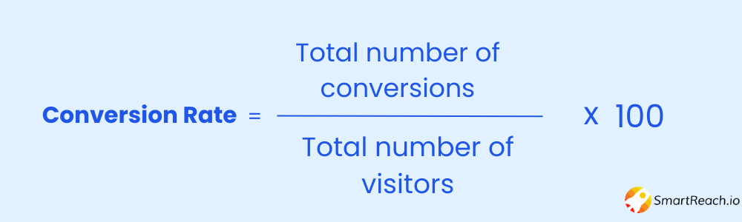
TRAFFIC SOURCE ANALYSIS-5
CVR from sessions to order. If CVR is 4% >=, then increase bids to drive volume, otherwise reduce bids. (Filter sessions < 2012-04-12, utm_source = gsearch and utm_campaign = nonbrand)
session_count | order_count | conversion_rate | bid_adjustment
3613 | 107 | 2.96% | Reduce Bids

Slide 58
TRAFFIC SOURCE ANALYSIS-6
After bidding down on Apr 15, 2012, the trend and impact on sessions for gsearch nonbrand campaign and weekly sessions before May 10, 2012.
Weekly traffic from gsearch nonbrand ads was around 900 until April 15 2012. In all weeks after than weekly sessions haven’t crossed 700.
In the final week traffic declined to 400
So bidding down had a very clear impact on the traffic

Slide 59
TRAFFIC SOURCE ANALYSIS-7
Conversion rate from session to order by device type
People using desktop clearly have much higher conversion rate than people visiting the mobile.
This could be due to website being poorly optimized which turn away people

Slide 60
TRAFFIC SOURCE ANALYSIS-8
New v/s Repeat session conversion rates from 2014
New Sessions
Repeat Sessions
Conversion rate is slightly higher in repeat sessions. It could be because customers are more familiar on how to navigate through the website or they have made up their mind to purchase the products after their first visit
Revenue per session is slightly higher in repeat session . That is customer are willing to spend more on their repeat visit
Total Sessions
2.41 L
56 K
Total Orders
17,673
4607
Total Revenue
10.76 L
2.79 L
Conversion Percentage
7.3 %
8.2 %
Revenue per session
4.45
4.98

Slide 61
TRAFFIC SOURCE ANALYSIS-9
After bidding up on desktop channel on 2012-05-19,
Weekly session trend for both desktop and mobile
We can clearly see an increasing trend in weekly traffic for both desktop and mobile after bidding up.
But we see that growth in mobile sessions is not proportional to growth of desktop sessions.
After week 2 , traffic through mobile is relatively stable

Slide 62
TRAFFIC SOURCE ANALYSIS -10
First time vs repeat visit of customers. Percentage of each group comes through Direct type-in vs Organic search vs Paid ads (from 2014)
80% of first time purchase sessions were from paid ads .Only 33% of repeat purchases were from paid ads
9% of customers already knew about the website even before they made first purchase
11% of first time customers found the website through organic search
30% of repeat purchase sessions were direct type in which means customers bookmarked the website when they first visited

Slide 63
TRAFFIC SOURCE ANALYSIS - 11
Recommendations
UTM Content
B_ad_2 has the highest conversion rate. The business should examine whether this performance is driven by higher ad quality or lower competition on Bing
Since social_ad_1 is underperforming, it may be necessary to pause the ad or increase its bid to improve visibility and test its potential further. Given that social_ad_2 has a 5x higher conversion rate, strategies or creative elements from social_ad_2 could be replicated or A/B tested in social_ad_1
G_ad_1 has higher traffic but a lower conversion rate than G_ad_2. The business should refine targeting, optimize the landing page for user intent, and A/B test ad creatives to improve conversion rates. Additionally, reviewing keywords and bidding strategies can ensure traffic quality
Device Type
The desktop website has a 3x higher conversion rate than the mobile website. The business should optimize the mobile user experience by improving site speed, navigation, and mobile-specific design to close the performance gap

Slide 64
TRAFFIC SOURCE ANALYSIS - 11
Recommendations
Traffic Type
Only 11% of first-time purchase sessions came through organic search. The business should consider increasing focus on SEO strategies, improving content visibility, and optimizing for relevant search queries to drive more organic traffic and boost first-time purchases
UTM Campaign
Brand ads have a higher conversion rate than non-branded ads. The business should consider allocating more budget towards brand-focused campaigns while continuing to optimize non-branded ads for better performance and targeting.

Slide 65


Slide 66
CHANNEL PORTFOLIO MANAGEMENT-1
Session count for gsearch and bsearch from August 22nd to November 30th
Friday shows the highest session data at 22,274, indicating peak user engagement or traffic.
Saturday and Sunday show a significant drop in session data. This could be due to users prioritizing personal time over online engagement during weekends.
Given the high traffic on Friday, it could be beneficial to concentrate marketing, promotions, or major announcements around this day to maximize reach.

Slide 67
CHANNEL PORTFOLIO MANAGEMENT-2
Gsearch and Bsearch non-brand sessions segmented by device type and start of the week (November 4th to December 22nd)
Desktop Sessions By Week Start
On 24-11-2014, "gsearch“ has higher session counts 3,767 sessions, while "bsearch" had only 904 sessions. This indicates that "gsearch" is a stronger traffic source for desktop users.

Slide 68
CHANNEL PORTFOLIO MANAGEMENT-3
Gsearch and Bsearch non-brand sessions segmented by device type and start of the week (November 4th to December 22nd)
Mobile Session By Week Start
On 25-11-2014, "gsearch“ has higher session counts 1600 sessions, while "bsearch" had only 128 sessions. This indicates that "gsearch" is a stronger traffic source for mobile users.

Slide 69
CHANNEL PORTFOLIO MANAGEMENT-4
Direct Type-in, Organic, Paid Brand Sessions Percentage by Months

Slide 70
CHANNEL PORTFOLIO MANAGEMENT
Observations:
We can see a spike in organic search, direct type in and paid brand sessions in Jan 2013. This could be due to our product launch in that month
Total session from above channels reach the highest in our last month – Mar 2015
Overall trend is that share of above channels is increasing each month while the share of paid non brand channel is decreasing
Percentage of organic search direct type in and paid brand search has seen a sharp rise in Nov 2014 and reached highest point in Jan 2015 , but has seen a sharp decline since then .

Slide 71
CHANNEL PORTFOLIO MANAGEMENT-5
Conversion rates for ‘nonbrand’ campaign of gsearch and bsearch by device type from August 22nd to September 18th
The "gsearch desktop" segment has the highest number of total sessions (12,000) and the highest conversion rate (7%), leading to a substantial number of orders.
The "gsearch mobile" segment has a significantly lower conversion rate (3%) compared to "gsearch desktop." Despite having 6,000 sessions, mobile traffic is less effective at converting than desktop traffic.

Slide 72
CHANNEL PORTFOLIO MANAGEMENT-6
Mobile sessions data for non-brand campaigns of gsearch and bsearch
from August 22nd to November 30th
utm_source | total_sessions | mobile_sessions | percentage_mobile_session
bsearch | 18529 | 2416 | 13%
gsearch | 82709 | 26293 | 31%
It is showing that gsearch has the highest traffic in mobiles about 31%.
Notes:
Subtitle

Slide 73
CHANNEL PORTFOLIO MANAGEMENT-7
Recommendations
Focus on leveraging periods of high "gsearch_session_count" was on peaks around 24-11-2014 and 01-12-2014 by ensuring sufficient inventory, targeted marketing, and promotional campaigns. This can capitalize on increased traffic to convert sessions into sales effectively.
Investigate "bsearch_session_count" lower than "gsearch_session_count" and implement strategies to increase engagement. This could include improving the bsearch platform's user experience, enhancing its search functionality, or running exclusive offers to attract users.
Enhance marketing and promotional efforts during late November and early December to maximize conversions, as session counts peak during these weeks.
Direct Sessions: Boost direct engagement by running email campaigns or promoting bookmark-worthy content to encourage repeat visits.
Organic Sessions: Focus on SEO strategies like keyword optimization and content creation to improve organic search visibility, especially during lower-performing months (April to June).

Slide 74
CHANNEL PORTFOLIO MANAGEMENT-8
Recommendations
Paid Sessions: Optimize ad spend in high-performing months (October to December) to maximize ROI and reduce budgets during low-traffic periods (April to June).
Since Saturday and Sunday have the lowest session counts, consider introducing special weekend promotions, exclusive content, or events to drive more traffic during these days.
Focus marketing efforts on Friday and Monday, which show the highest engagement, to capitalize on already strong traffic. Offer time-sensitive deals or targeted campaigns to maximize revenue.
Since 31% of Gsearch sessions are mobile, ensuring a smooth, fast, and responsive mobile experience can help increase engagement and conversion rates for mobile users.
Enhance the mobile user experience to boost its conversion rate (3.18%), as it trails behind desktop (7.80%). Invest in mobile-friendly design, simplified checkout processes, and personalized offers for mobile users.

Slide 75
COHORT ANALYSIS
April 2014 –March 2015
Cohort | Apr-14 | May-14 | Jun-14 | Jul-14 | Aug-14 | Sep-14 | Oct-14 | Nov-14 | Dec-14 | Jan-15 | Feb-15 | Mar-15
Apr-14 | 1239 | 22 | 5 | 0 | 0 | 0 | 0 | 0 | 0 | 0 | 0 | 0
May-14 |  | 1340 | 10 | 7 | 3 | 0 | 0 | 0 | 0 | 0 | 0 | 0
Jun-14 |  |  | 1221 | 11 | 5 | 2 | 0 | 0 | 0 | 0 | 0 | 0
Jul-14 |  |  |  | 1260 | 7 | 12 | 1 | 0 | 0 | 0 | 0 | 0
Aug-14 |  |  |  |  | 1306 | 16 | 7 | 1 | 0 | 0 | 0 | 0
Sep-14 |  |  |  |  |  | 1385 | 15 | 8 | 4 | 1 | 0 | 0
Oct-14 |  |  |  |  |  |  | 1580 | 18 | 10 | 3 | 0 | 0
Nov-14 |  |  |  |  |  |  |  | 1951 | 23 | 8 | 5 | 0
Dec-14 |  |  |  |  |  |  |  |  | 2264 | 25 | 14 | 4
Jan-15 |  |  |  |  |  |  |  |  |  | 2049 | 30 | 15
Feb-15 |  |  |  |  |  |  |  |  |  |  | 2004 | 16
Mar-15 |  |  |  |  |  |  |  |  |  |  |  | 1214
We perform cohort analysis on the last 12 months in the dataset.
We see that retention is low. Customers from each cohort retained only 3 months on an average.
But retention is increasing gradually after every new month. In Jan 2015 cohort, just in first 2 months there are 45 customers who came for repeat purchase .
The new customers in each cohort month are high in 2015 when compared to 2014.
Both increase in cohort customers and retention of customers is good for the company.

Slide 76
RFM SEGMENTATION-1
Using the NTILE(4) function, divided customers into quartiles for each metric-
Recency_Score: Customers are ranked by recency in ascending order, so lower recency (more recent) receives a higher score.
Frequency_Score: Customers are ranked by order frequency in descending order, so higher frequency receives a higher score.
Monetary_Score: Customers are ranked by spending (monetary value) in descending order, so higher spending receives a higher score.
Each score will be between 1 (lowest) and 4 (highest), resulting in an RFM score for each customer.
Added up the RFM scores (Recency_Score + Frequency_Score + Monetary_Score) for each customer to get a Total_RFM_Score.
Segment | RFM Score
Premium | >10
Gold | 9, 10
Silver | 7, 8
Standard | <6
It allows the business to identify high-value customers (Premium) and target each segment accordingly for personalized marketing, loyalty programs, or other strategies.

Slide 77
RFM SEGMENTATION-2
Standard Segment:
This segment has the highest number of customers, meaning most customers have lower RFM scores and are likely to have less recent, less frequent purchases and lower monetary value.
They may need more engagement or promotional efforts to encourage higher spending and repeat purchases, or they may represent casual or one-time buyers.
Silver Segment:
Silver customers have slightly better RFM scores than Standard and might be relatively recent buyers with occasional purchases and moderate spending.
They may be receptive to targeted campaigns encouraging more frequent purchases or larger transactions to move them up to the Gold segment.
Gold Segment:
While they are fewer in number than Standard and Silver, they represent valuable and engaged customers.
This group may benefit from loyalty programs or exclusive offers to further increase their frequency or spending, potentially moving some of them to the Premium level.
Premium Segment:
The smallest segment by count, Premium customers have the highest RFM scores, meaning they are highly recent, frequent buyers with high monetary value and represents the most loyal and valuable customers and should be treated as VIPs, possibly with premium services, personalized offers, or early access to new products.
Retaining these customers is essential as they contribute significantly to revenue despite being the smallest group by count.

Slide 78
RFM SEGMENTATION-3
Standard Segment:
Standard customers generate a moderate share of total revenue and this indicates that their sheer volume helps contribute a sizable amount to overall revenue.
Standard customers are likely low-value, high-volume buyers. Targeted strategies like upselling and incentives for higher frequency or higher spend per purchase could help increase their contribution.
Silver Segment:
The Silver segment contributes a notably high share of revenue relative to its count, representing a mix of fairly recent, somewhat frequent purchasers who spend at a moderate level.
They already contribute a considerable amount of revenue, Silver customers have the potential to be upgraded to the Gold segment through focused campaigns encouraging repeat purchases or loyalty rewards.
Gold Segment:
Gold customers also contribute significant revenue and consists of customers with regular, substantial purchases.
These customers are valuable mid-to-high spenders who are loyal and can be nurtured to move into the Premium segment through exclusive rewards and enhanced customer experiences.
Premium Segment:
Although the smallest in count, Premium customers drive a high share of the total revenue and show that they are recent, frequent, and high-spending customers, making them the most valuable segment.
Given their importance, it’s crucial to retain and prioritize these customers with VIP-level experiences, early access, and highly personalized interactions.

Slide 79

PRODUCT ANALYSIS

Slide 80
PRODUCT ANALYSIS
Breakdown of sales by product , 2013

Slide 81
PRODUCT ANALYSIS
Breakdown of sales by product , 2014

Slide 82
PRODUCT ANALYSIS
Breakdown of sales by product , 2015

Slide 83
PRODUCT ANALYSIS
Observations
The Original Mr. Fuzzy is consistently the top-selling product across all months in the years shown, significantly outperforming the other products in sales volume.
There is a noticeable increase in sales for ‘The Original Mr. Fuzzy’ during December for each year, indicating a strong holiday season surge.
Other notable peaks for ‘The Original Mr. Fuzzy’ include January 2015 and November 2014.
‘The Hudson River Mini Bear’ seems to have the lowest sales, while ‘The Birthday Sugar Panda’ and ‘The Forever Love Bear’ have relatively higher and somewhat competitive sales.
The sales of all products tend to follow similar monthly patterns, but ‘The Original Mr. Fuzzy’ dominates in both the total count and growth rate month-over-month.

Slide 84
PRODUCT ANALYSIS
Monthly conversion rate since April 2013
Conversion rate is highest in Feb 2015 with 8.69%
Conversion rate is lowest in Nov 2013 with 6.14%
As each year passes, we see increase in conversion rate

Slide 85
PRODUCT ANALYSIS
Revenue per session since April 2013
Revenue per session is highest in Feb 2015 and lowest in November 2012
As each year passes, revenue/session keeps on increasing, from 3 to 5

Slide 86
PRODUCT ANALYSIS
Revenue per product since April 2013
Revenue from original Original Mrfuzzy is over 3 times the revenue of 2nd most sold product
HudsonRiver Mini Bear has the lowest sales among the 4 products

Slide 87
Cross Sold Products
Product 1 | Product 2 | Orders count
The Original Mr. Fuzzy | The Hudson River Mini bear | 3142
The Original Mr. Fuzzy | The Birthday Sugar Panda | 2036
The Original Mr. Fuzzy | The Forever Love Bear | 944
The Forever Love Bear | The Hudson River Mini bear | 680
The Birthday Sugar Panda | The Hudson River Mini bear | 662
The Forever Love Bear | The Birthday Sugar Panda | 248
Option to add a second product on the /cart page was launched on 2013-09-25 at 08:49:13.000.
Utilize customer purchase history and browsing behaviour to offer personalized cross-sell recommendations, ensuring relevance and increasing the likelihood of additional purchases.
Feature top cross-sell products prominently on product pages, in shopping carts, and during the checkout process to remind customers of complementary items they might be interested in.
Company can offer discounted price when customers purchase 2 diff products together which encourages customers to buy multiple related products.

Slide 88
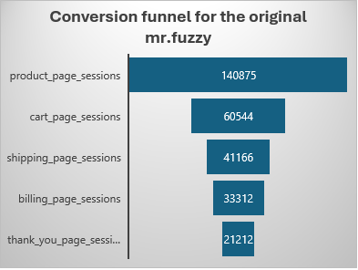
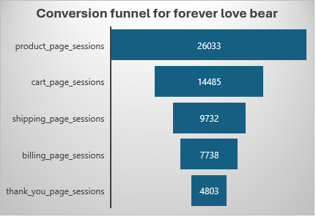
PRODUCT ANALYSIS
Product Conversion Funnels

Slide 89
PRODUCT ANALYSIS
Observations
Conversion funnel for the ‘Original Mr. Fuzzy’ product, showing the number of sessions at each stage of the conversion process. Starting with 140,875 sessions on the product page, only 60,544 sessions progress to the cart page.
Fewer sessions proceed to the billing page (33,312) and even fewer make it to the thank-you page (21,212). The final thank-you page has only 21,212 sessions out of the original 140,875, showing an approximate overall conversion rate of around 15%
onversion funnel for the ‘Forever Love Bear’ product shows the number of sessions at each stage of the conversion process.
Out of 26,033 sessions on the product page, only 14,485 move to the cart page.
From the original 26,033 sessions on the product page, only 4,803 make it to the thank-you page, resulting in a conversion rate of around 18%.
While this is an improvement over the ‘Original Mr. Fuzzy’ conversion rate, there is still room for improvement.

Slide 90
PRODUCT ANALYSIS
Click Through Rates and Revenue Before and After Option Launch
This indicates a positive impact of the changes made during the launch, leading to slightly higher customer engagement.
The increase of revenue aligns with the higher CTR and suggests that the launch strategy effectively boosted customer interaction and spending.
The 2.45% rise in CTR might seem small, but it has driven a noticeable 13.31% revenue growth, indicating the effectiveness of the changes.
The data suggests a correlation between improved engagement (CTR) and financial performance (revenue).

Slide 91
PRODUCT ANALYSIS
Avg Product per Order and Avg Order Value Before and After Option Launch
4.37% increase in the number of products customers are buying per order, suggesting improved product bundling or upselling strategies.
Average order value increased after the launch, reflecting a 5.41% growth. This aligns with the increase in products per order, meaning customers are spending more per transaction, likely due to effective pricing, promotions, or cross-selling efforts.
The data highlights a positive impact of the launch on customer behavior, leading to higher product purchases and order values.
Strategies such as cross-selling, bundled discounts, or targeted marketing could be driving these improvements.

Slide 92
Comparing the month before and the month after the launch of the “Birthday Bear” product on December 12th, 2013
Sessions, Orders and Conversion rates
A 84.22% increase in website traffic suggests effective marketing campaigns, improved SEO, or increased brand awareness after the launch.
More than Double Increase in Orders ie 143.89% increase, driven by higher traffic.
A 32.48% increase in the proportion of sessions resulting in orders. This indicates that post-launch strategies like improved user experience, targeted promotions, or optimized product pages were successful in converting visitors into buyers.

Slide 93
PRODUCT ANALYSIS
Comparing Total Revenue and Avg Order Value
22.42% rise in Average order value indicates customers are spending more per transaction after the launch, possibly due to effective upselling, cross-selling, or pricing strategies.
Massive Increase in Total Revenue ie 201.64% increase reflects the combined effects of increased traffic, higher conversion rates, and improved AOV.
The substantial growth in revenue and AOV suggests that the post-launch initiatives (e.g., marketing, product improvements, or promotional strategies) were highly successful in driving customer engagement and sales.

Slide 94
PRODUCT ANALYSIS
Comparing Average Products per Order
The average products per order increased 32.03%. This indicates that after the launch, customers are adding more items to their orders, which could be due to successful upselling, cross-selling, or bundled product offers.
The rise in products per order suggests that customers are more inclined to purchase additional products, potentially driven by effective product recommendations or marketing strategies that encourage multi-product purchases.

Slide 95
PRODUCT ANALYSIS
Monthly Product Refund Rates

Slide 96
PRODUCT ANALYSIS
Monthly Product Refund Rates

Slide 97
PRODUCT ANALYSIS
Monthly Product Refund Rates

Slide 98
PRODUCT ANALYSIS
Observations
In 2012 and 2013, ‘The Original Mr. Fuzzy’ shows consistently higher refund rates compared to other products, often above 5%. The rate reaches 8.45% in July 2013.
2014 : The refund rate for ‘The Original Mr. Fuzzy’ is generally low throughout the year, except for a significant spike in September, 2014 to 20.17%
2014 : ‘The Birthday Sugar Panda’ maintains higher refund rates throughout the year, peaking at 7.14% in August, 2014.
2014 : ‘The Forever Love Bear’ and ‘The Hudson River Mini Bear’ show consistently low refund rates.
The spikes in September for ‘The Original Mr. Fuzzy’ (especially in 2014) may suggest an isolated issue during that month, possibly related to quality or supply problems.
Across 2013 and 2014, ‘The Forever Love Bear’ has the most stable and lowest refund rates, usually ranging between 1% to 3%.
There is no clear seasonal pattern affecting all products uniformly, but July and September seem to show peaks for ‘The Original Mr. Fuzzy’ in both 2013 and 2014.

Slide 99
PRODUCT ANALYSIS
Observations
Refund rates , 2015
The Birthday Sugar Panda consistently has the highest refund rate across all three months shown. The refund rate starts at 8.22% in the first month, slightly decreases to 4.20% in the second, and then rises significantly to 10.65% in the third month
The Original Mr. Fuzzy generally shows moderate refund rates that fluctuate over the months. It starts at 3.59% in the first month, decreases slightly to 3.77% in the second month, and then rises to 4.51% in the third month.
The Forever Love Bear has relatively low refund rates compared to other products, staying below 4% across the three months.
The Hudson River Mini Bear has the lowest refund rate in the first month (0.66%) and generally maintains low rates, though it does see a gradual increase across the months to 1.29% in the second month and 2.33% in the third month.

Slide 100
Recommendations
Bundle Products: Introduce bundle offers or "Buy X, Get Y" promotions to encourage customers to add more products to their orders.
Personalized Recommendations: Use data-driven algorithms to suggest complementary products during checkout, increasing the likelihood of additional purchases.
Upsell and Cross-Sell: Highlight premium product options or complementary items that can enhance the customer’s purchase experience.
Free Shipping Threshold: Set a slightly higher free shipping threshold (above the current AOV) to incentivize customers to spend more per order.
Continue Marketing Efforts: Scale up successful marketing strategies (e.g., paid ads, influencer collaborations, or email campaigns) that contributed to the surge in sessions.
Content Optimization: Publish high-value content like blogs or videos to maintain organic traffic momentum.
Loyalty Programs: Introduce reward systems for returning customers to encourage repeat purchases.
Post-Purchase Engagement: Send personalized follow-up emails with product recommendations or discounts for future purchases.

Slide 101
Recommendations
Retarget Abandoned Sessions: Use email or remarketing campaigns to target users who visited the site but did not place an order.
Enhance Checkout Process: Simplify the checkout process, ensuring fewer steps and easy payment options to reduce cart abandonment.
Simplify the Ordering Process: Ensure the process for adding products is seamless and user-friendly, especially for larger orders. This will help maintain the increased number of products added to each transaction.
Offer Discounts for Larger Orders: Provide small incentives or discounts for purchasing multiple products in one order, which can encourage customers to continue adding more items to their cart.
Targeted Campaigns: Focus marketing efforts on high-value customer segments identified during the post-launch period to sustain the increased AOV.
Dynamic Pricing: Implement dynamic pricing strategies that offer discounts for purchasing multiple items. For example, offer a discount when a customer adds a third or fourth item, incentivizing larger orders.
Free Shipping for Higher Orders: Provide free shipping for orders that contain a minimum number of products or exceed a certain value, motivating customers to add more items to their cart to take advantage of the offer.

Slide 102
Thank you!

